Slide 1
Evaluation
Supervised Learning

Slide 2
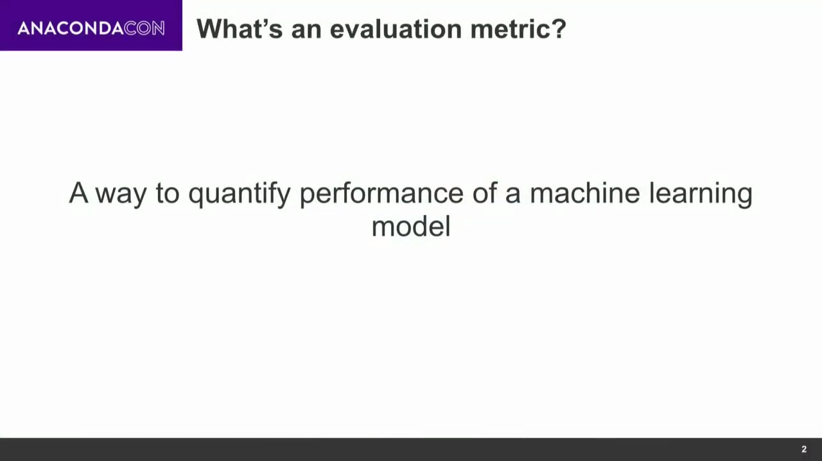
Notes:
Its basically a number that tells you the performace

Slide 3
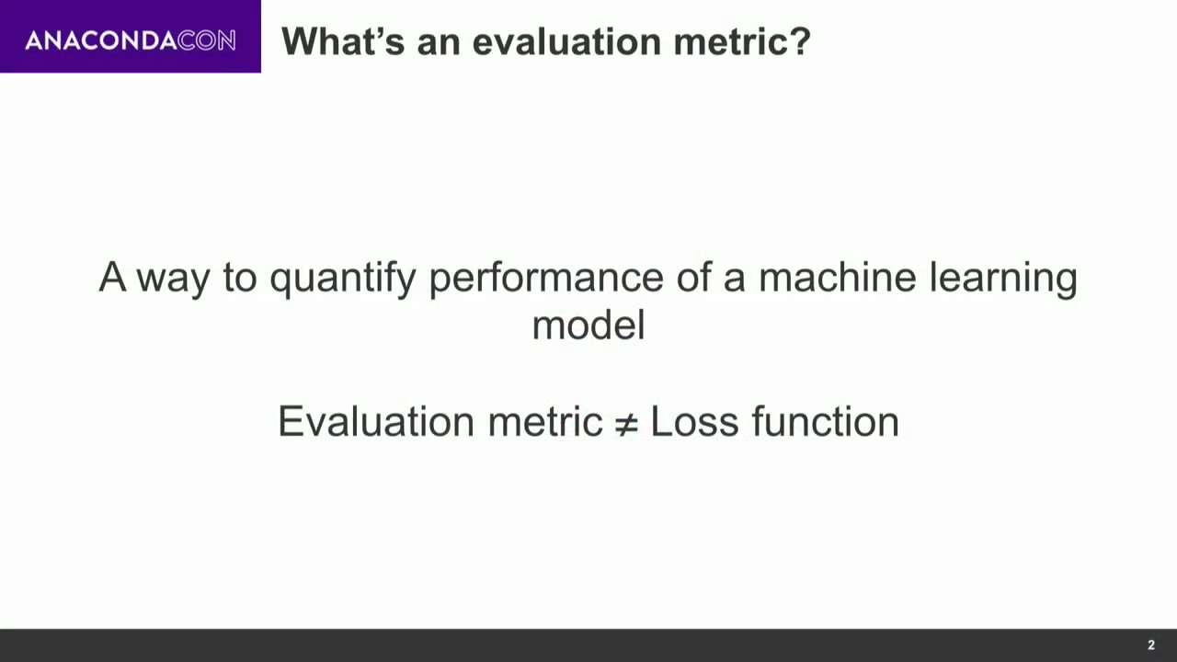
Notes:
Loss Function is used when you are training your model when your optimizing your model
Evaluation metric is used on already trained model to see that its any good

Slide 4
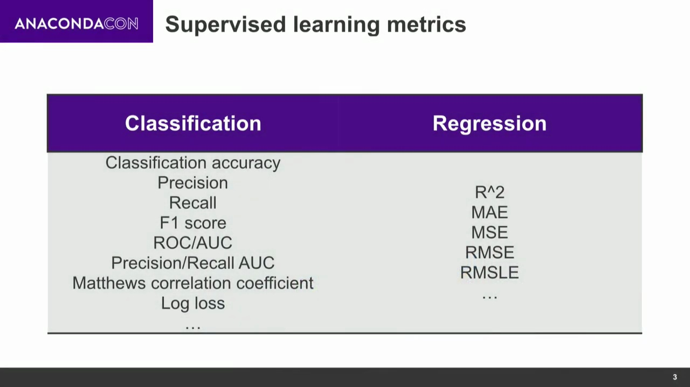
Notes:
not all will be covered these are main ones

Slide 5
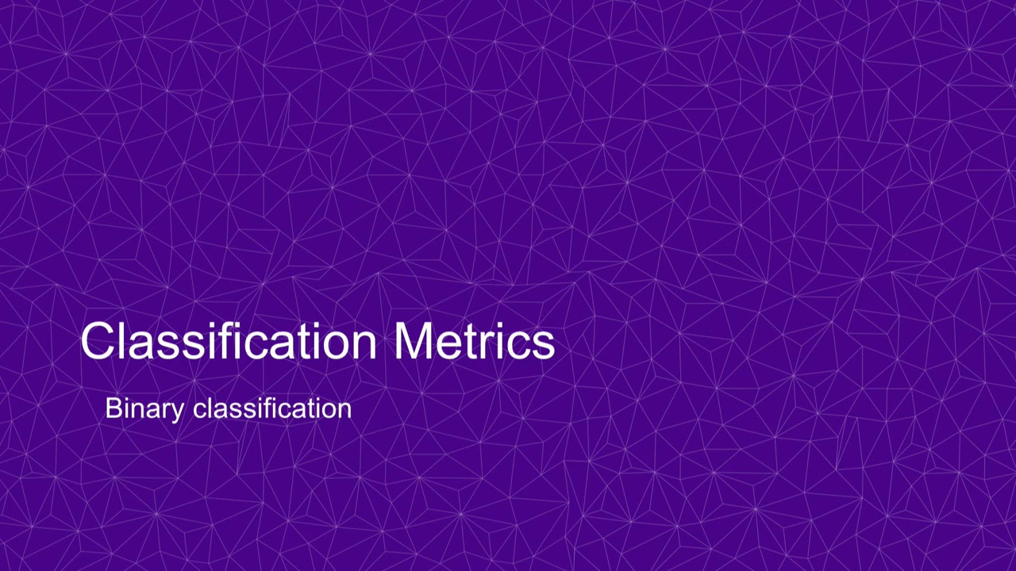
Notes:
to keep things simpel we will start with binary classification problem

Slide 6
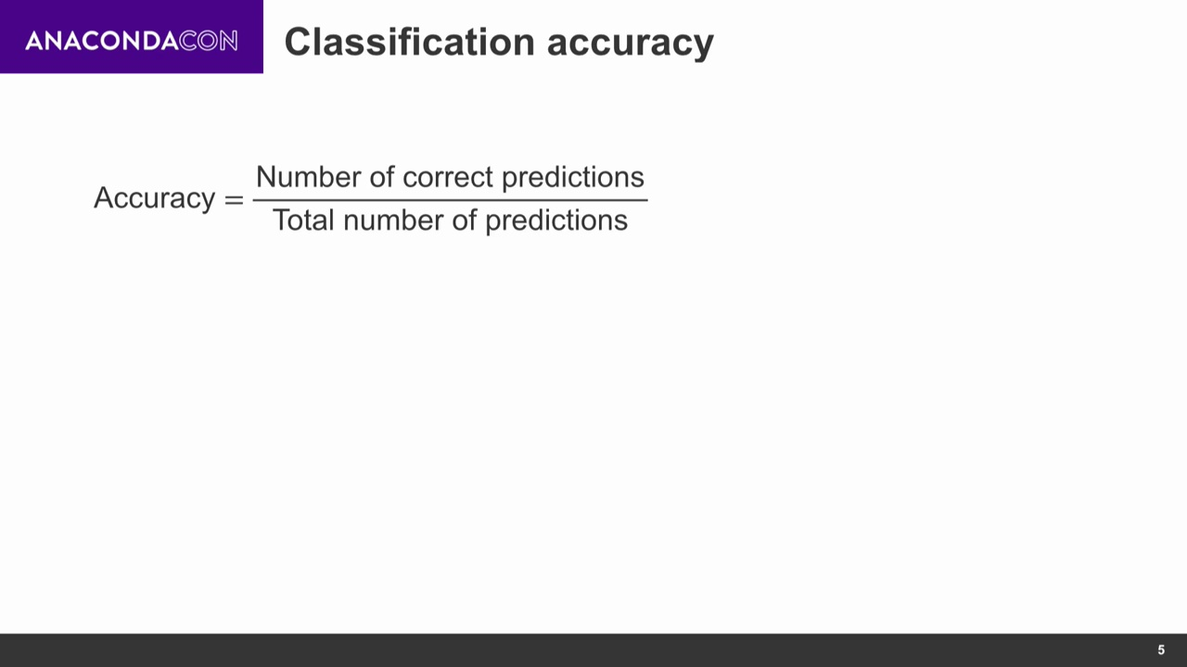
Notes:
super easy 0-1 or 0% to 100%

Slide 7
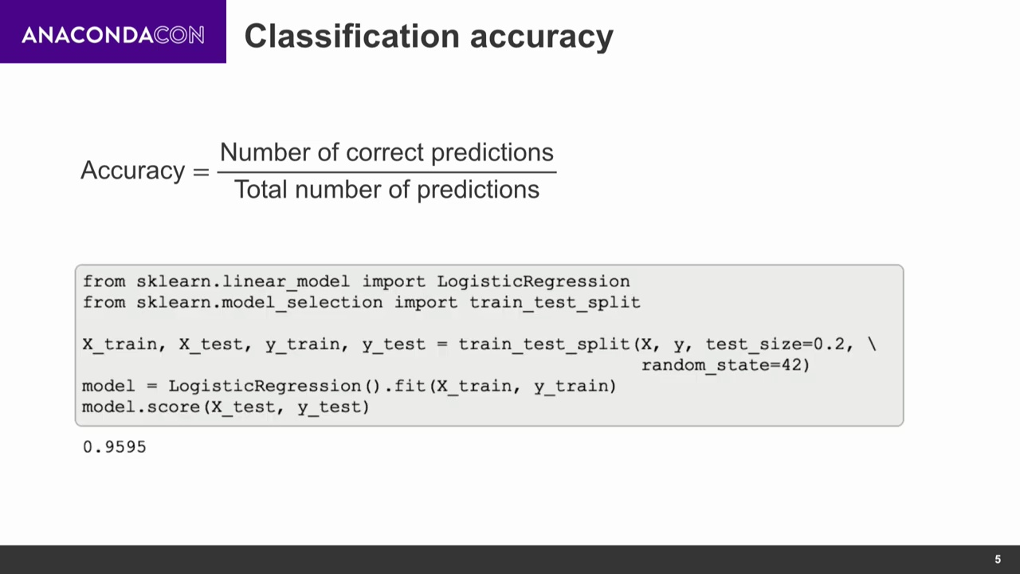
Notes:
with score method 96% looks amazing but it may not be good

Slide 8
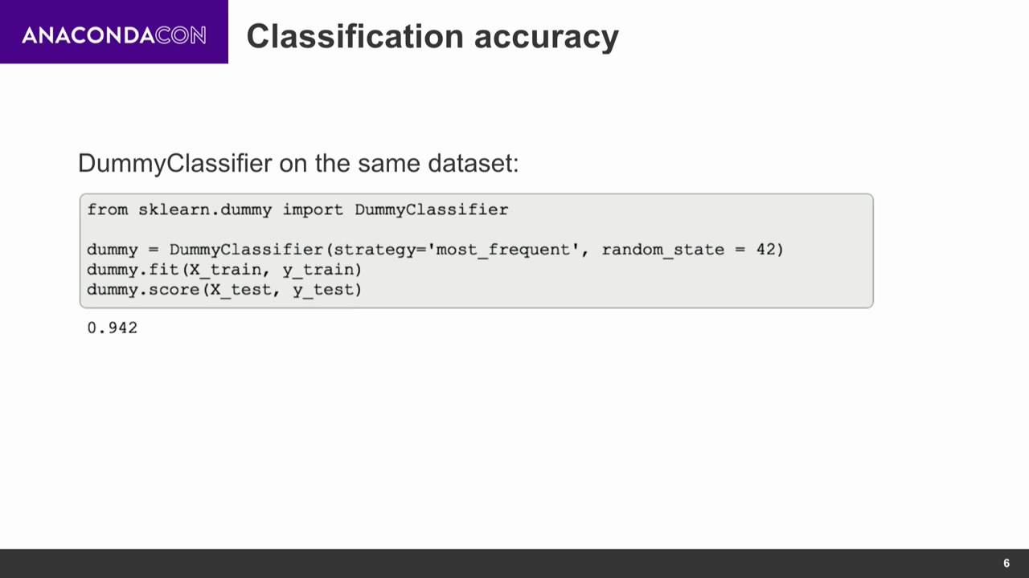
Notes:
dummy classifier in this case predicting on the basis of just most frequent class it has seen in training data getting 94%. The data was highly class imbalance.

Slide 9
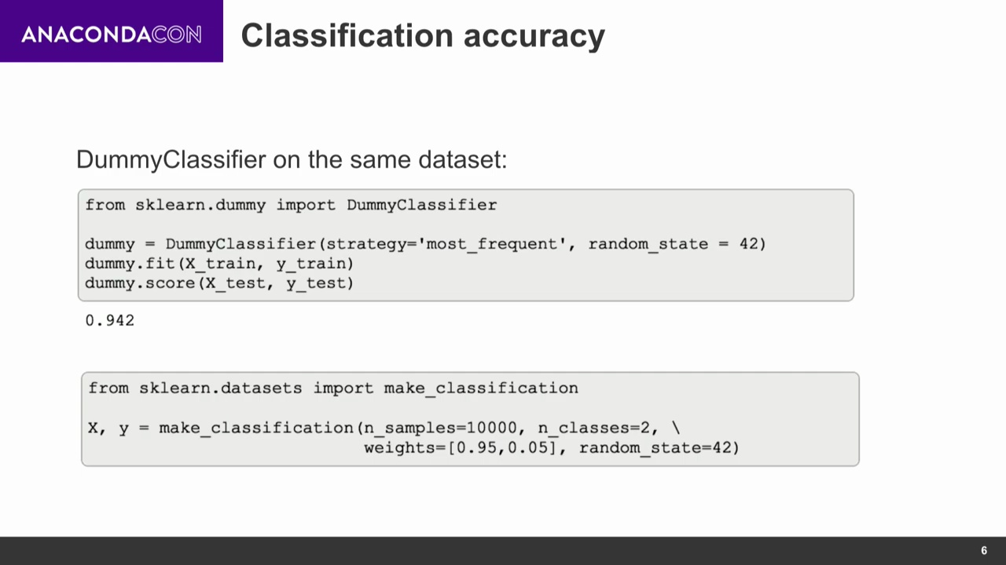

Slide 10
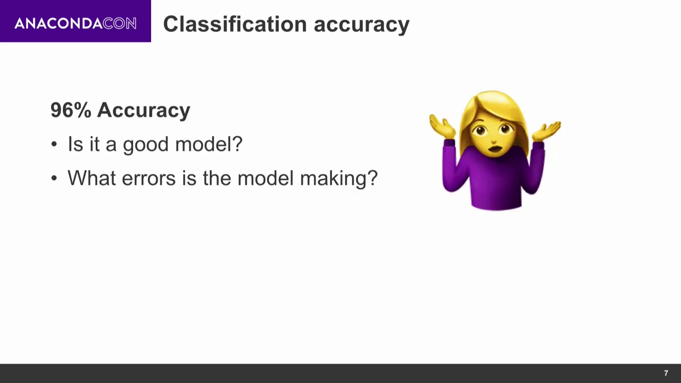
Notes:
with this number we cannot know whats the error its making or how to improve
There are a lot of other measures

Slide 11
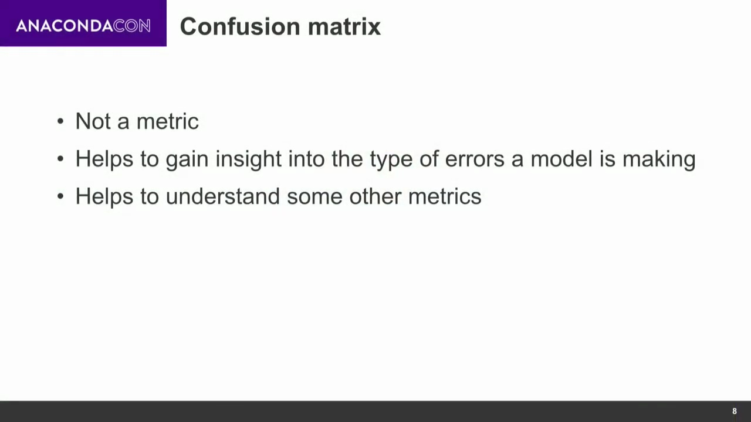
Notes:
it’s a diagnostic tool

Slide 12
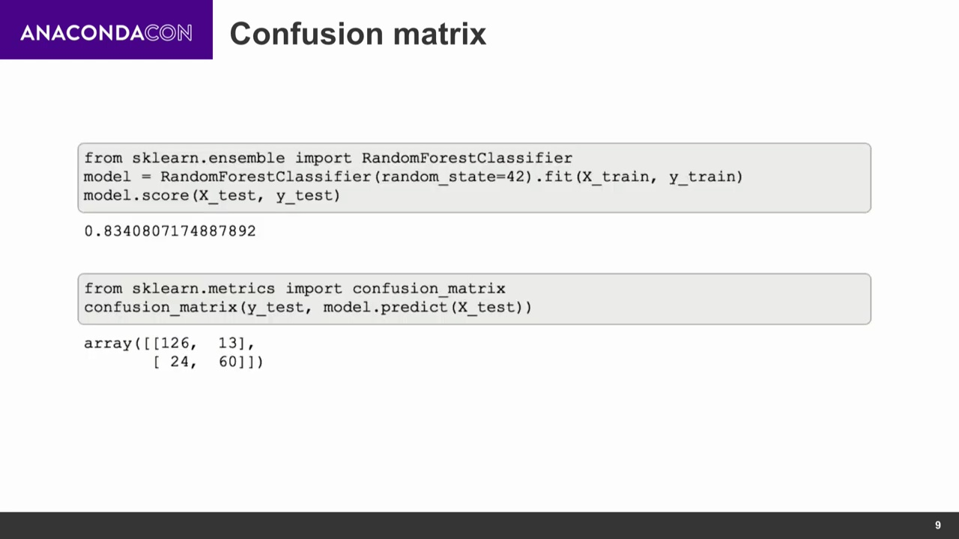

Slide 13
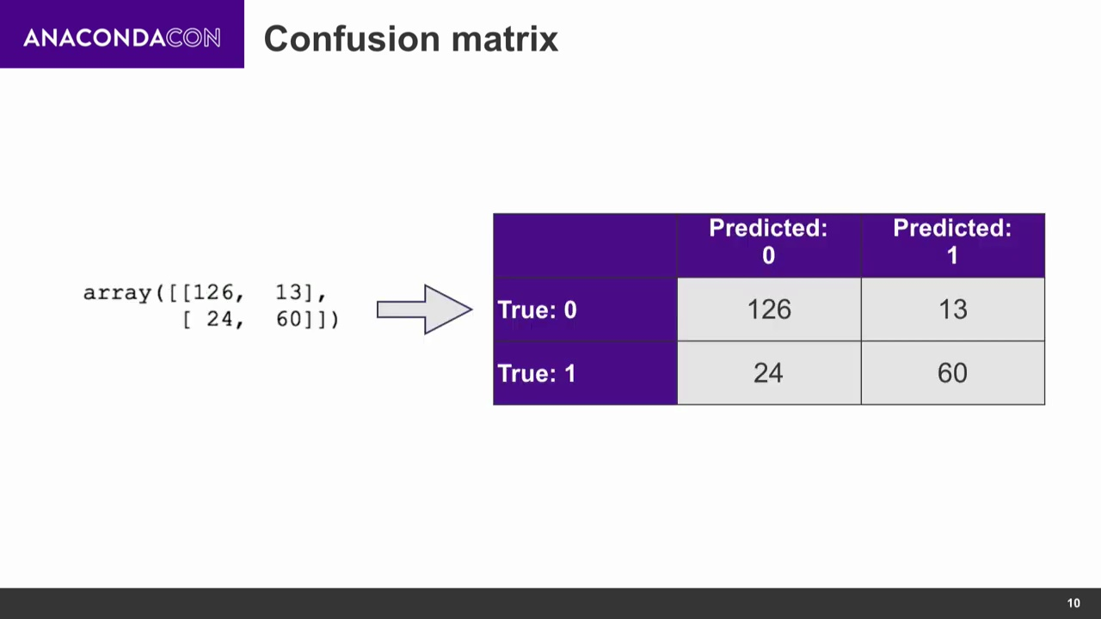
Notes:
Prediction on colums and Actual values on rows

Slide 14
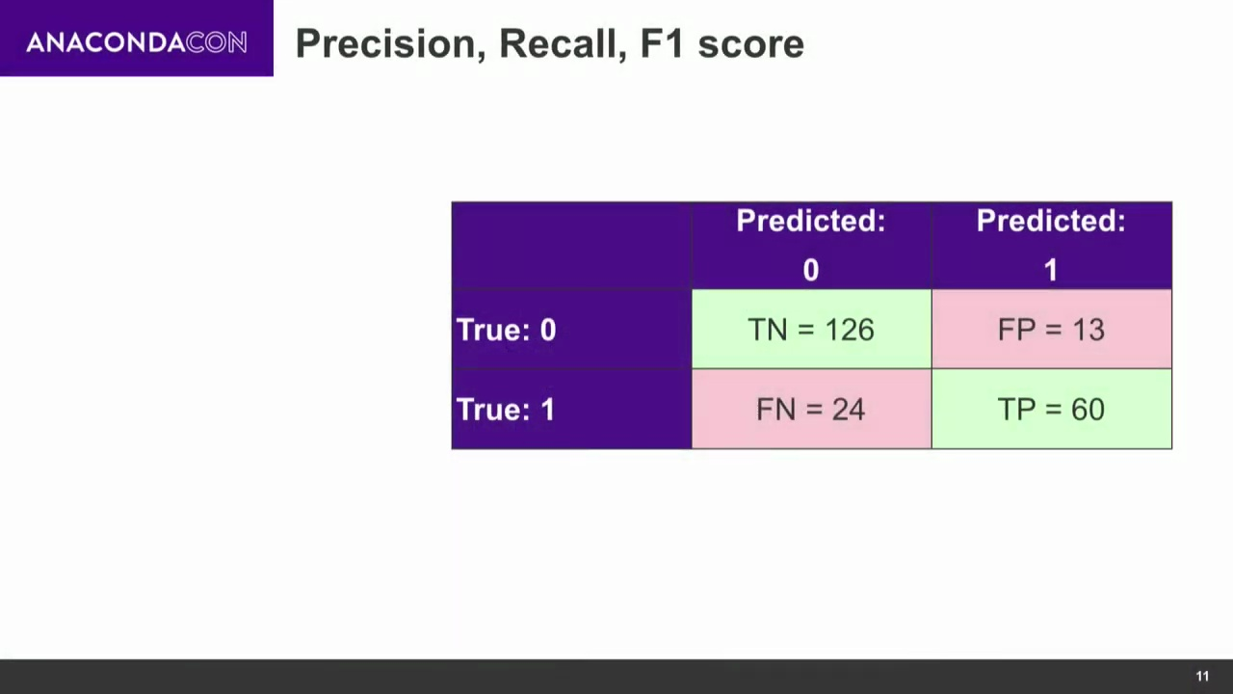
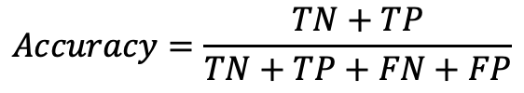
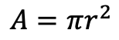
$$A=πr^{2}$$
$$Accuracy=\frac{TN+TP}{TN+TP+FN+FP}$$
Spam not Spam (ham):
Cancer not cancer:
FP is not desired
FN can be life threatening
Notes:
If you put an important email in spam its FP user will be annoyed . Email was predicted as spam while it was not.
Precision is important in this case

Slide 15
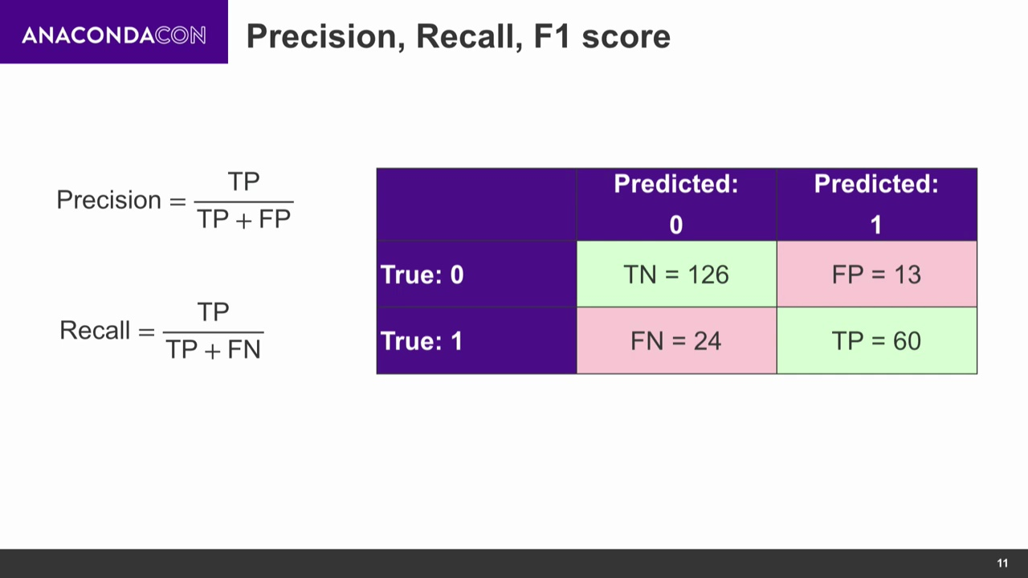
Notes:
If we have no FP it will be 1 and if have any it will reduce the precision.

Slide 16
Notes:
Medical diagnosis would want FN to be less or 0. it needs Recall

Slide 17
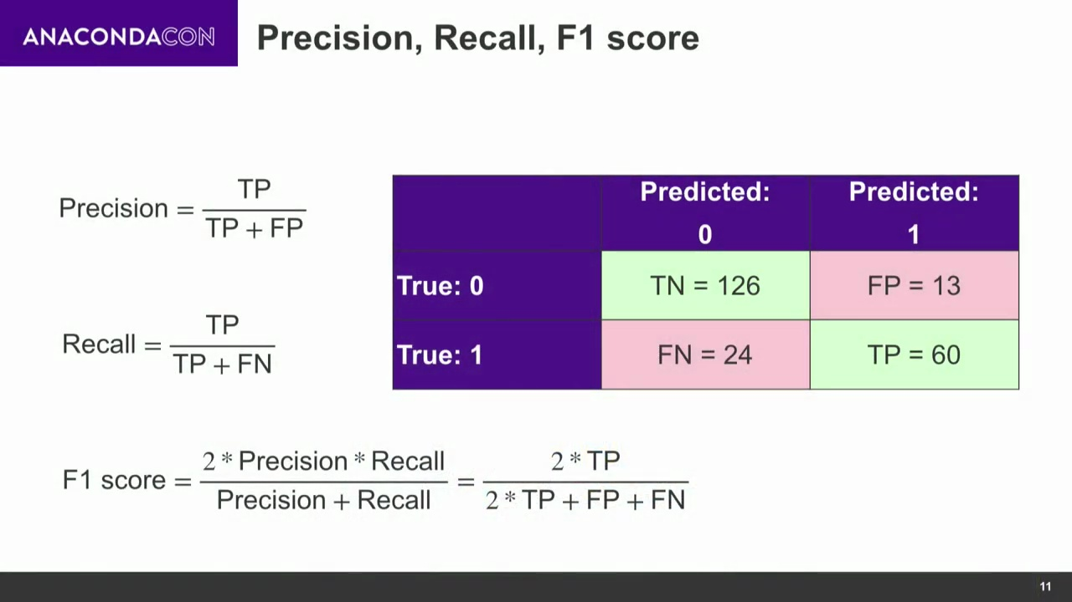

Slide 18
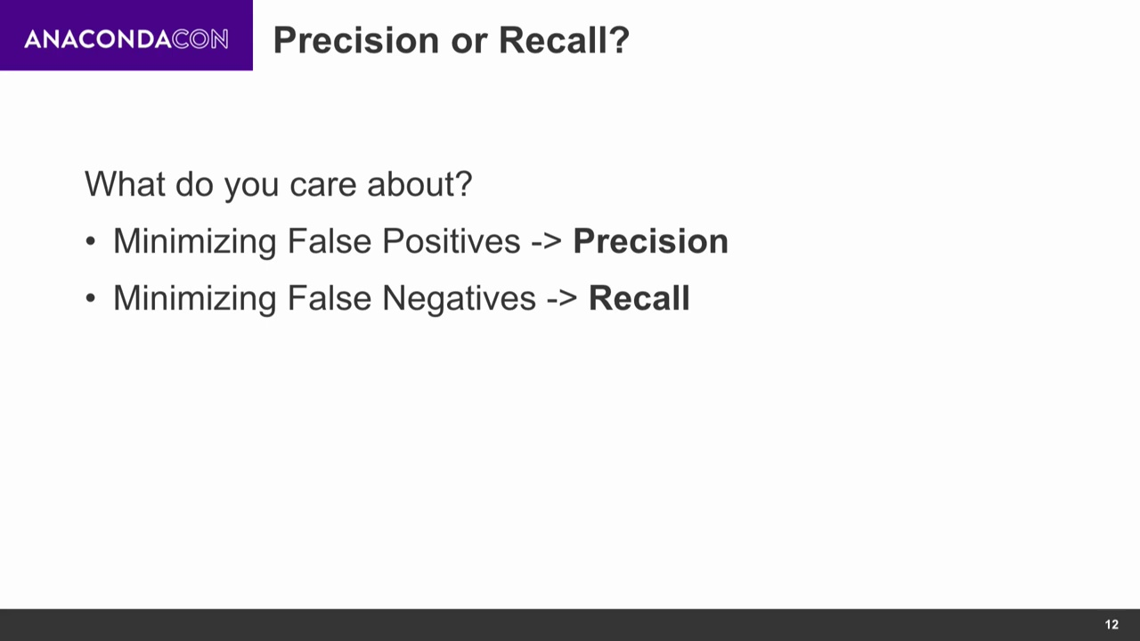

Slide 19
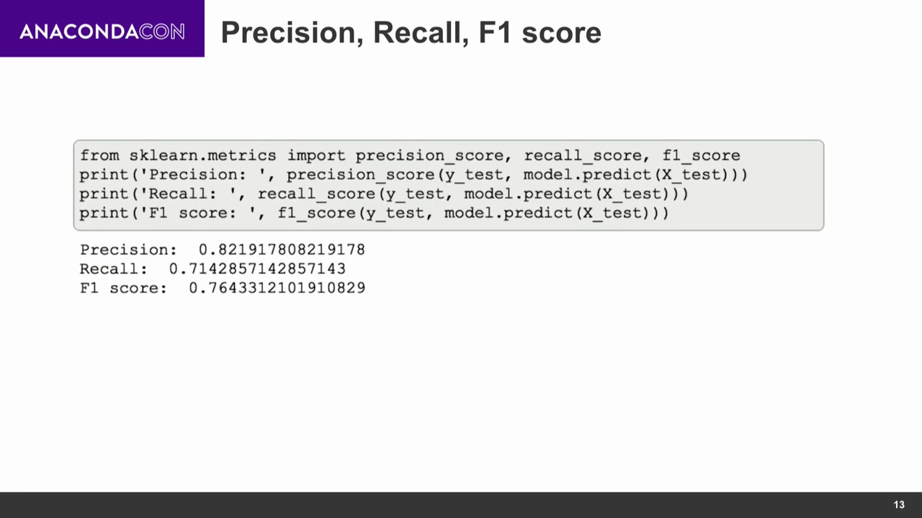

Slide 20


Slide 21
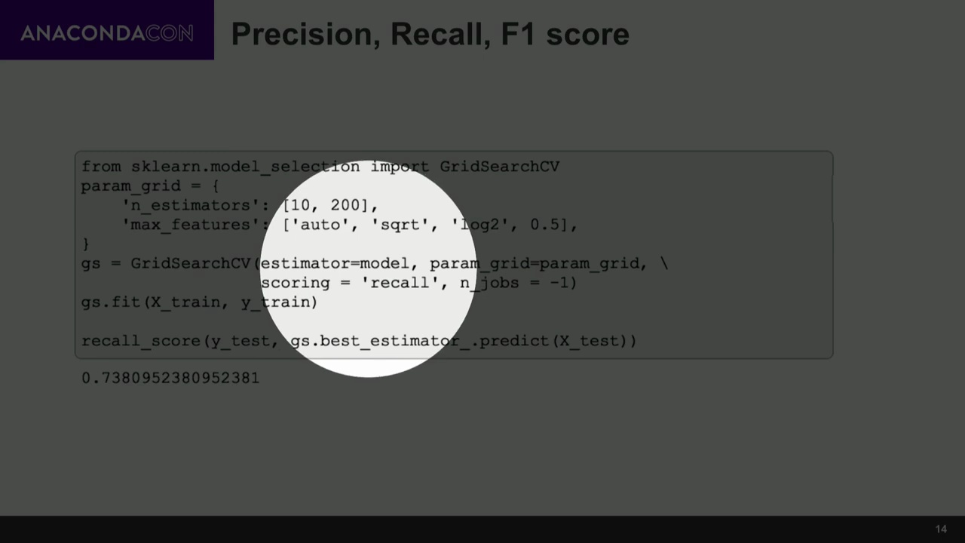

Slide 22
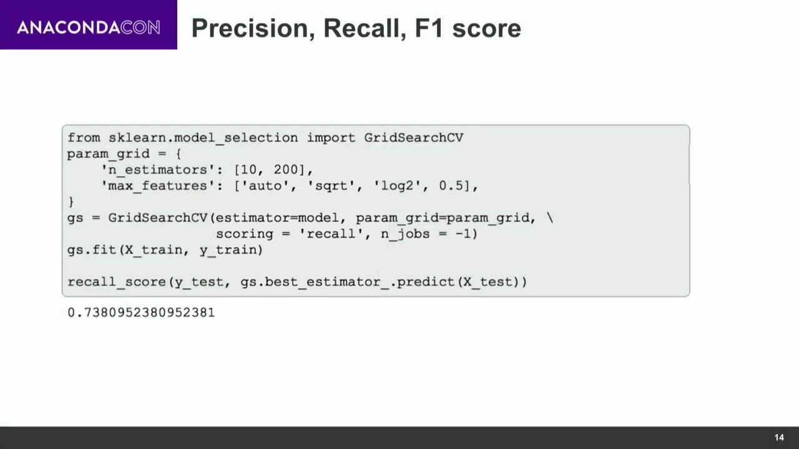

Slide 23
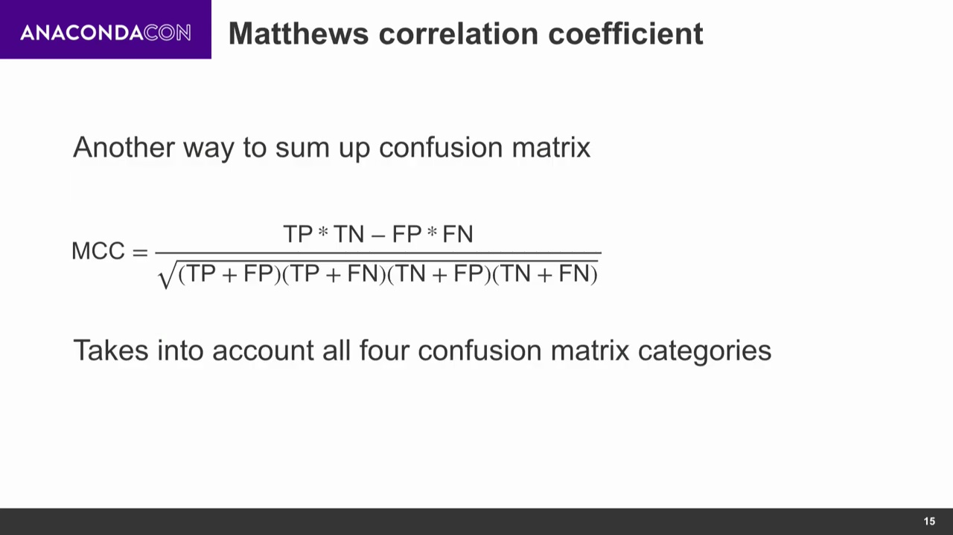
Notes:
Whats imp about this measure is that it takes into accoutn all four cells of CM

Slide 24
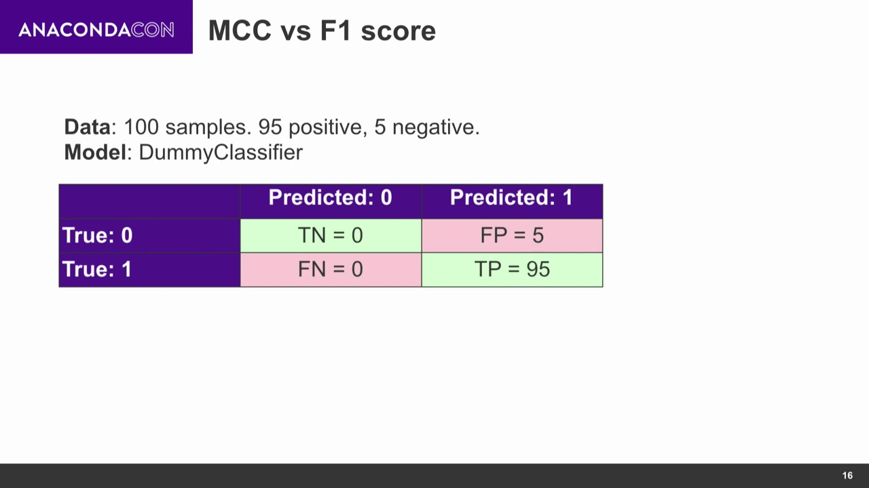

Slide 25
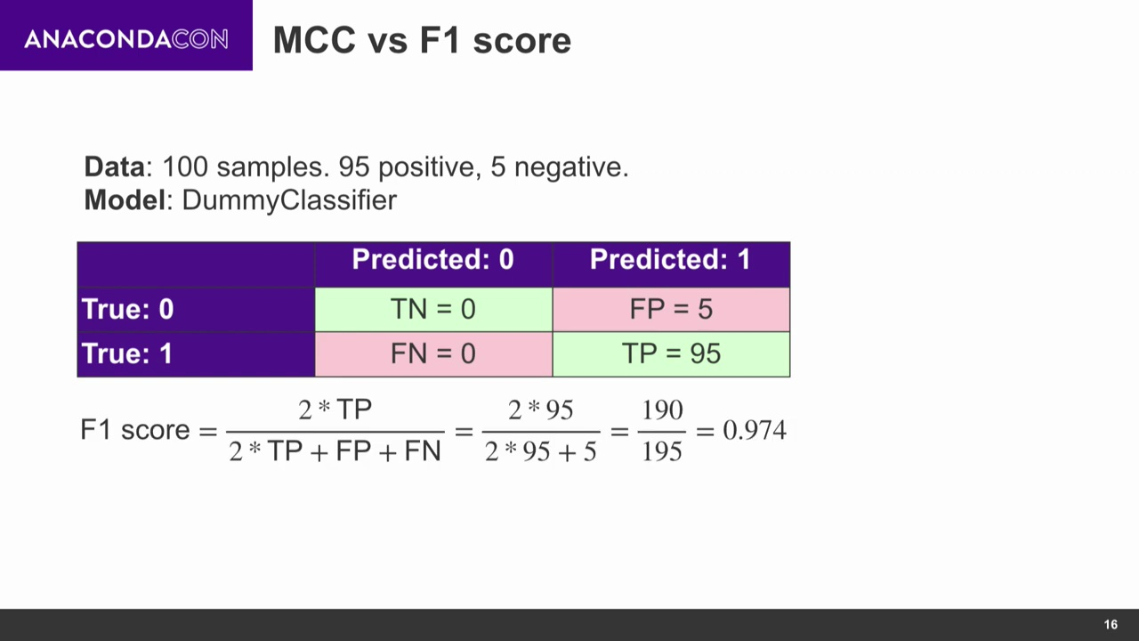

Slide 26
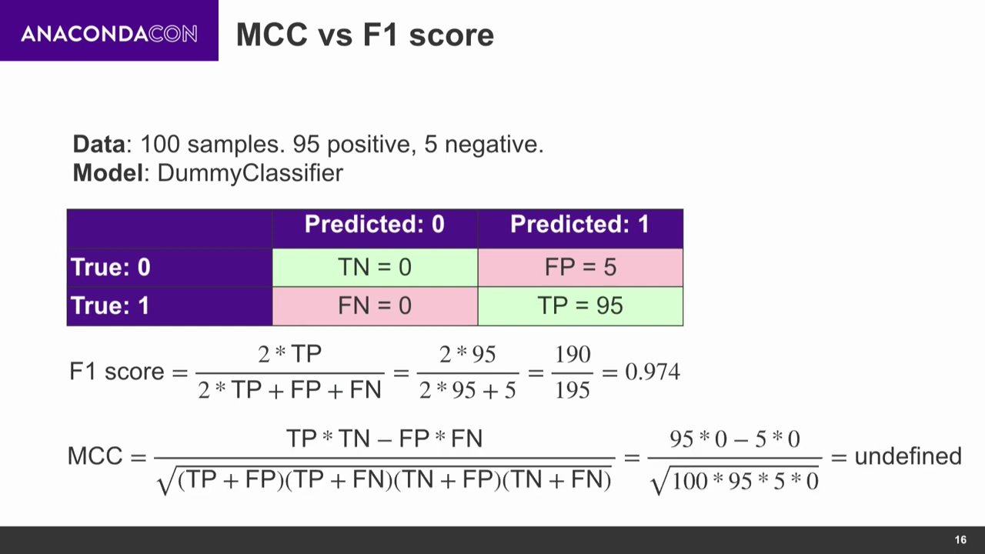
Notes:
MCC is undefined as it will dividing by zero giving you a red flag that there is something wrong about the model. It is because its dummy classifier

Slide 27
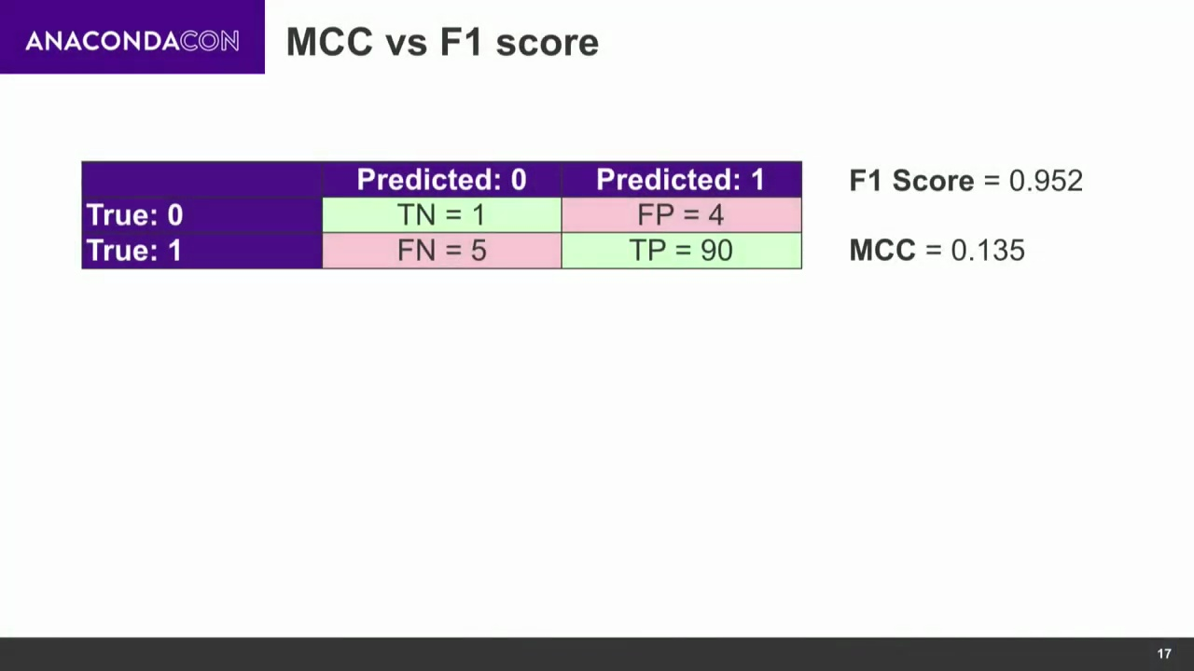

Slide 28
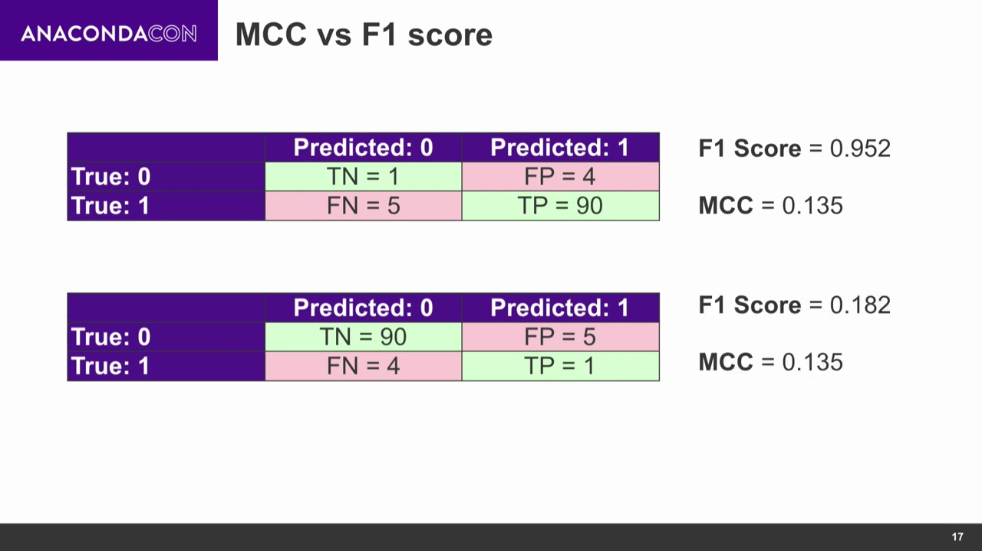
Swapped +ve & -ve
Notes:
F1 is sensitive to what you call a positive class and what you call a negative class while MCC is not. For binary problem is MCC is the best but it has its downside it doesn’t extend that well inot multiclass problem.
So far we have been taking into account models that tell you wetehr it belongs to one class or another but some classifies take into account probabilty of a unseen sample to be in one class or another.

Slide 29
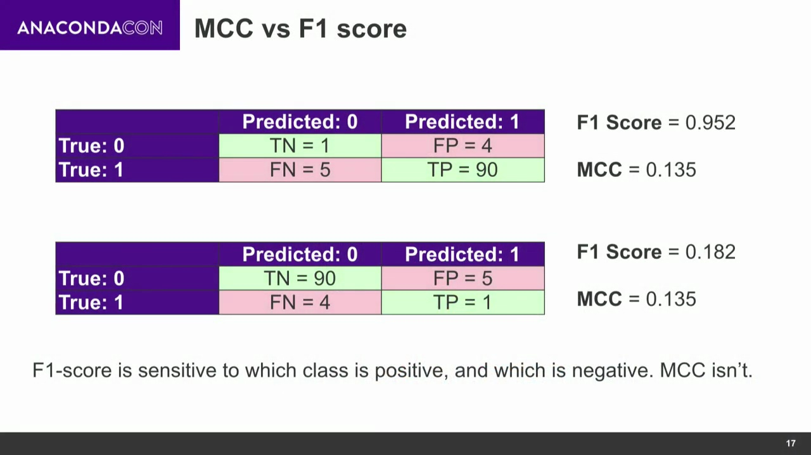
Doesn’t care about TN
MCC is for binary classification

Slide 30
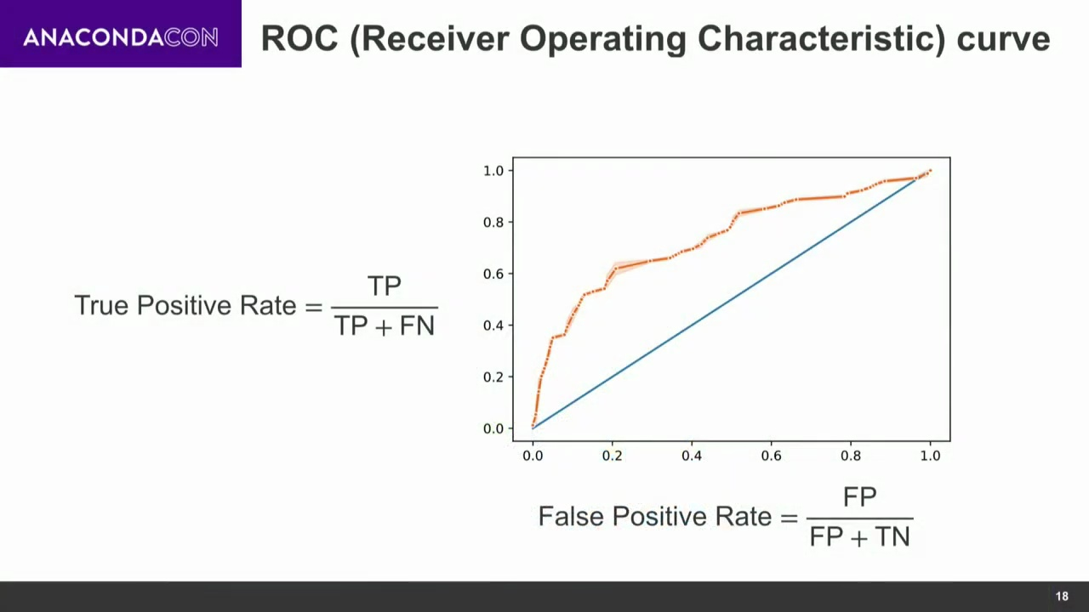
Notes:
Why is it a line not a points, its where probabilty threshold come to place to play when we have a probabilty genertaed of an example belonging to one class or the other. If we have 50% threshold where we decide if a prbbailty is larger than this postive class. You can move the threshold to 60, 70, 80. if an unseen sample was given positive class when threshold was 60 it might be negative when threshold is moved to 80.

Slide 31
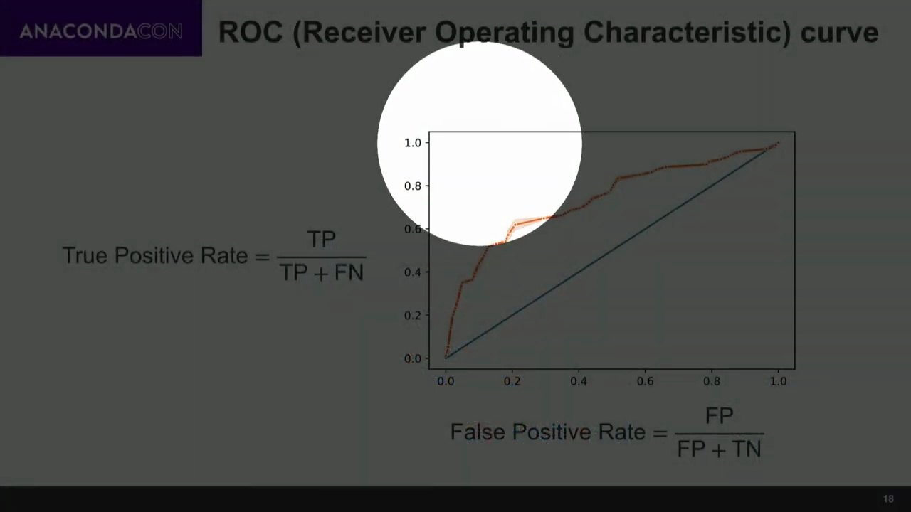

Slide 32
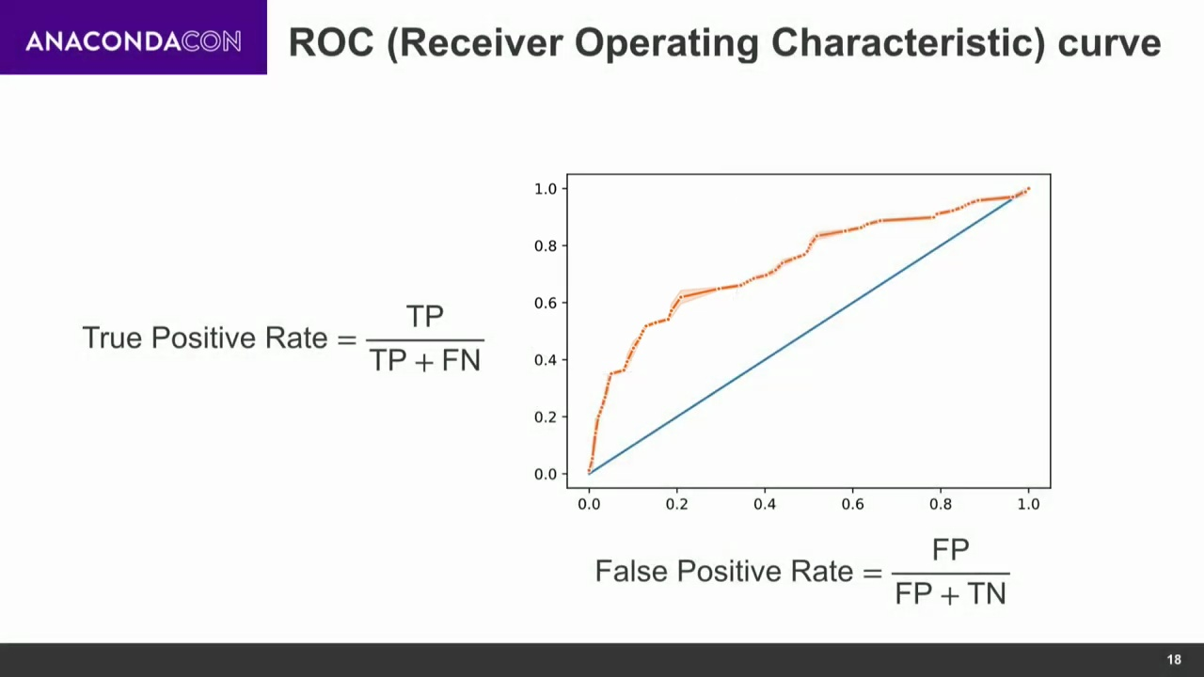

Slide 33
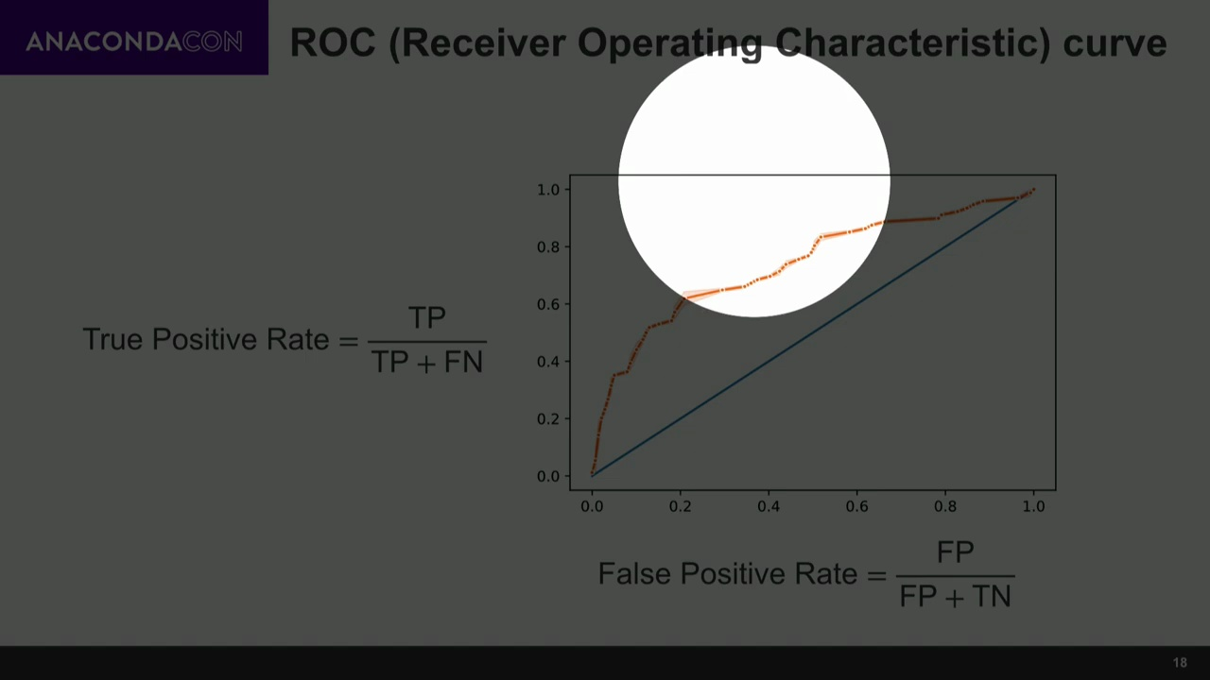

Slide 34


Slide 35
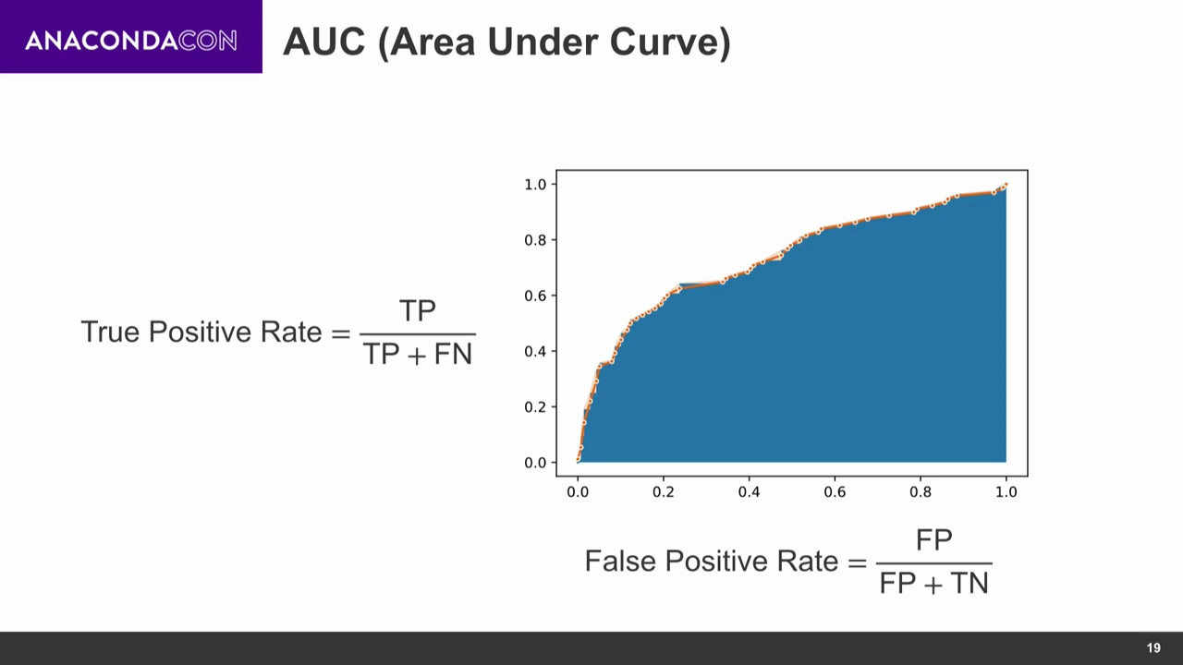

Slide 36
ROC and AUC
y | Y(prob) | Y(0) | Y(0.2)
1 | 0.8 | 1 TP | 1 TP
0 | 0.96 | 1 FP | 1 FP
1 | 0.4 | 1 TP | 1 TP
1 | 0.3 | 1 TP | 1 TP
0 | 0.2 | 1 FP | 0 TN
1 | 0.7 | 1 TP | 1 TP
TPR=TP/(TP+FN)
FPR = FP/(FP+TN)
For Y(0)
TP = 4/(4+0) = 1
FP = 2/(2+0) = 1
For Y(1)
TP = 4/(4+0) = 1
FP = 1/(1+1) = 0.5

Slide 37


Slide 38
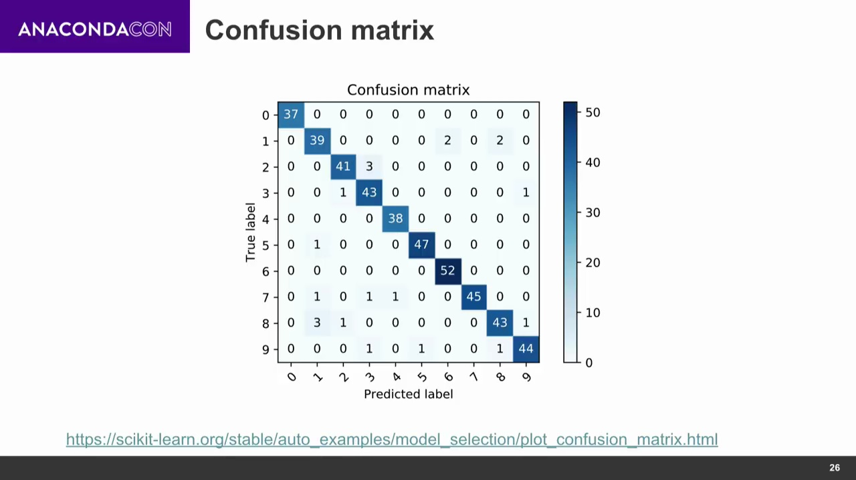

Slide 39
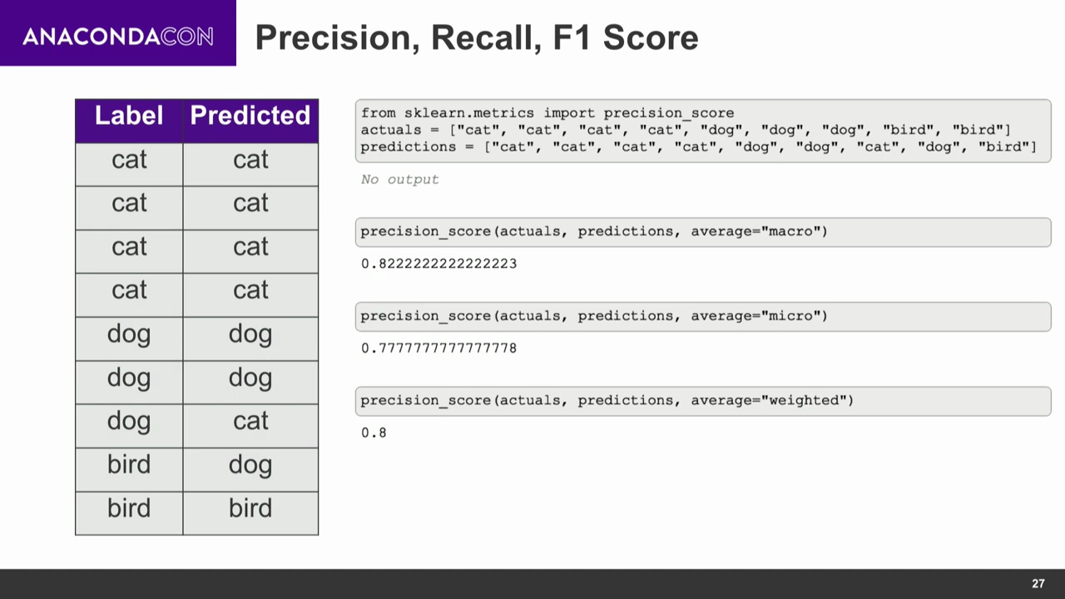

Slide 40
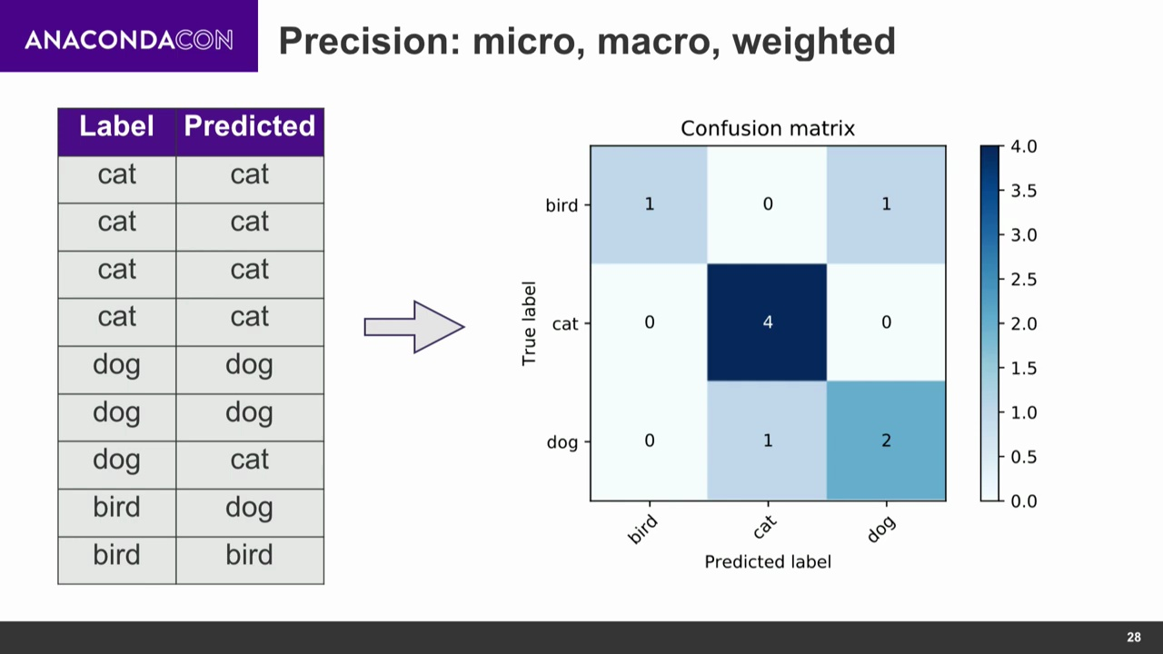

Slide 41
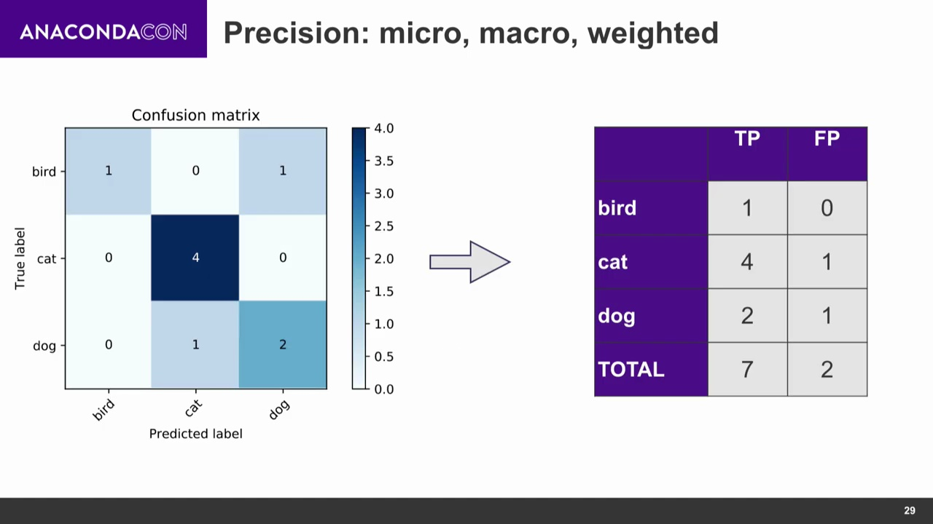
TP
FP

Slide 42
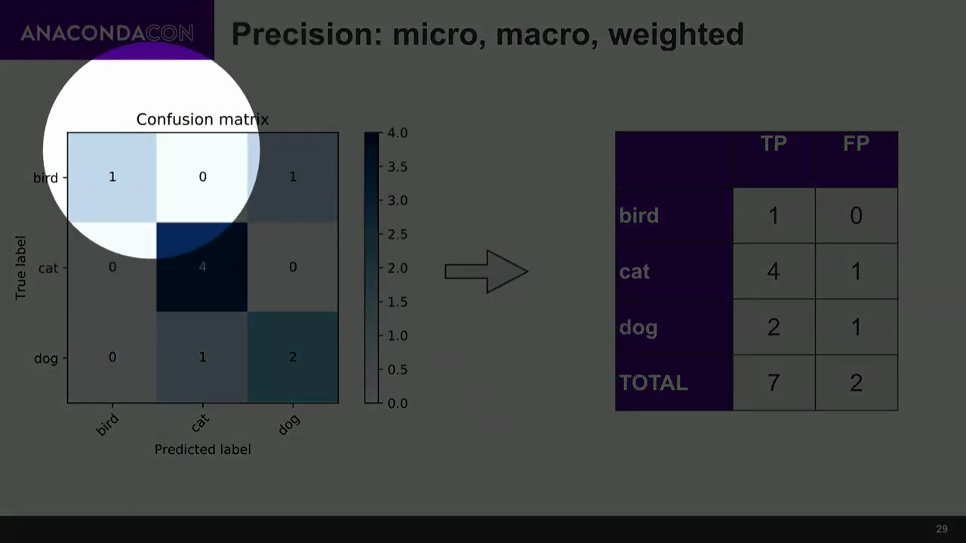

Slide 43
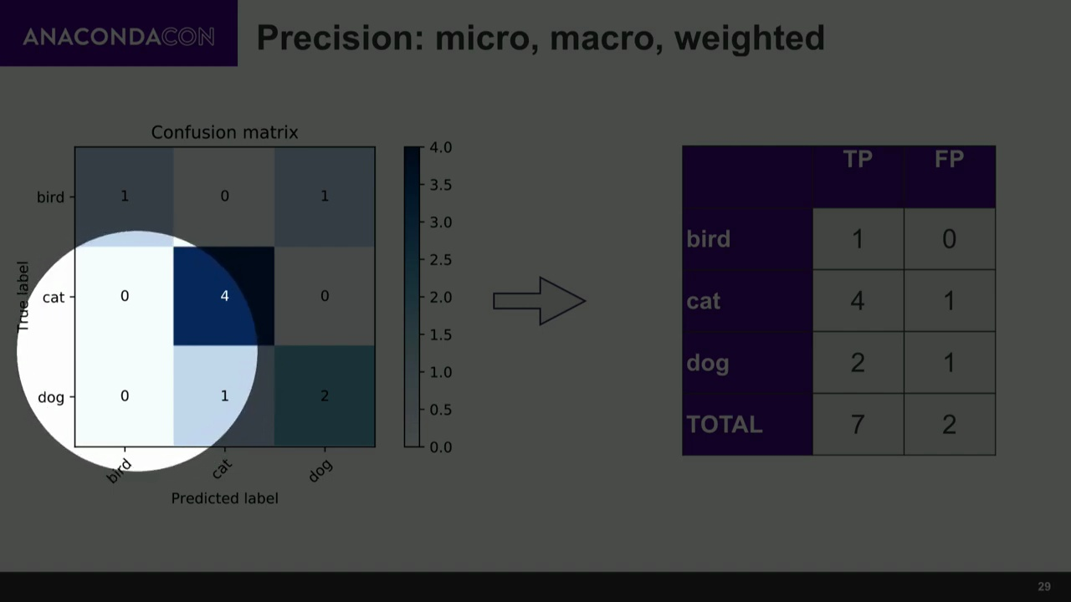

Slide 44
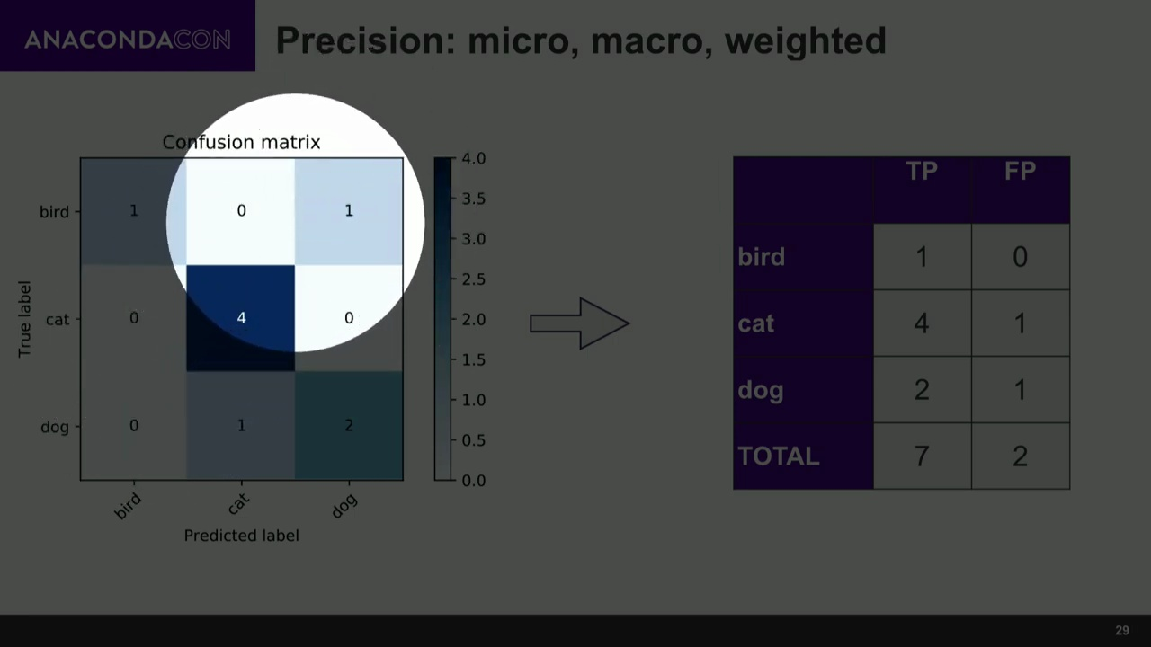

Slide 45


Slide 46
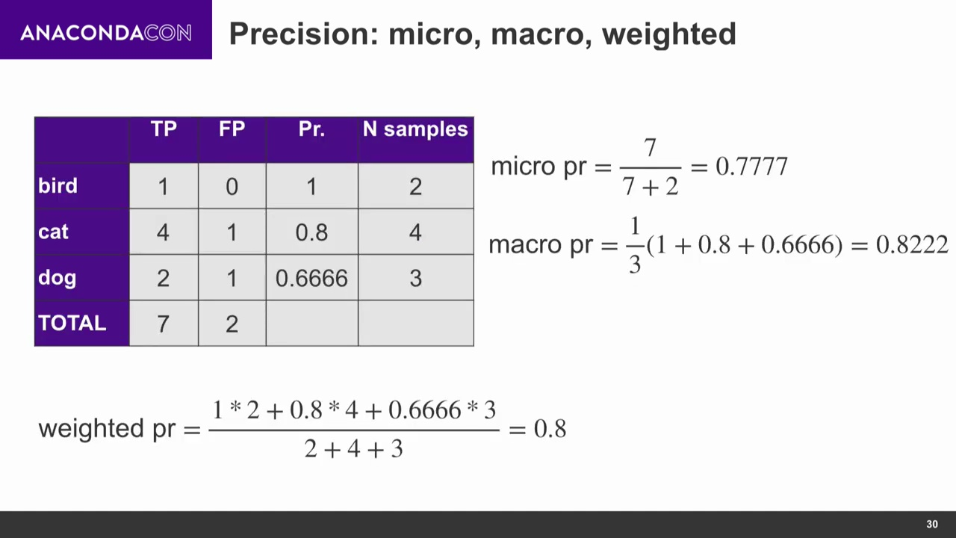
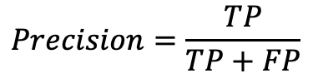
$$Precision=\frac{TP}{TP+FP}$$
Notes:
Macro pr = 1/3 (1 + 4/5 + 2/3)

Slide 47
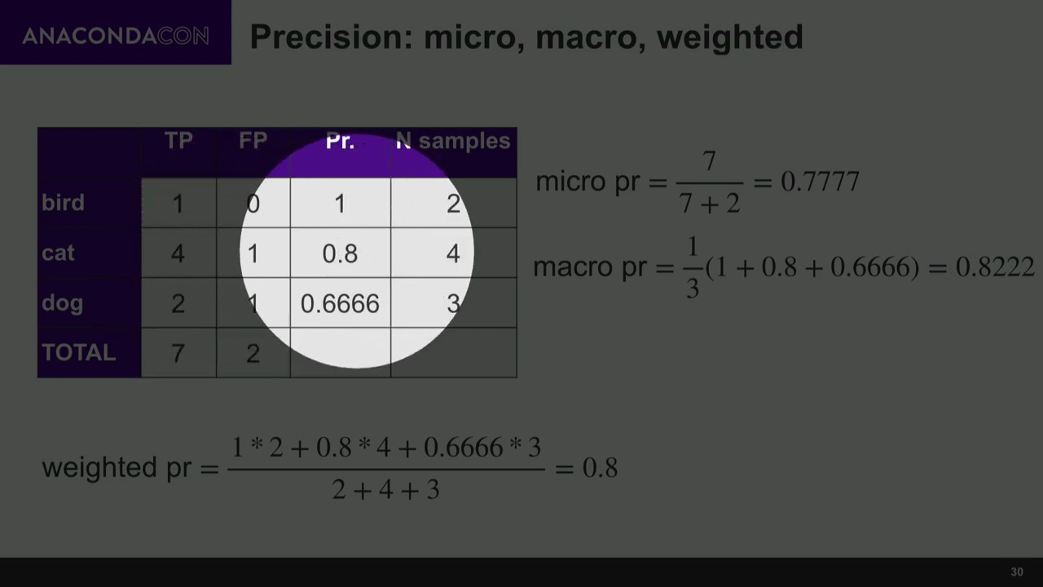

Slide 48


Slide 49
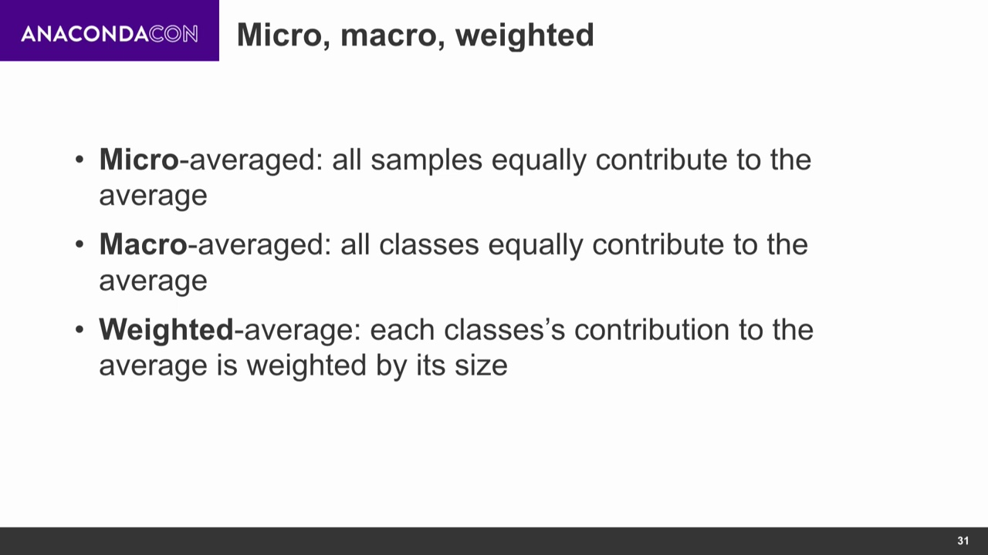

Slide 50
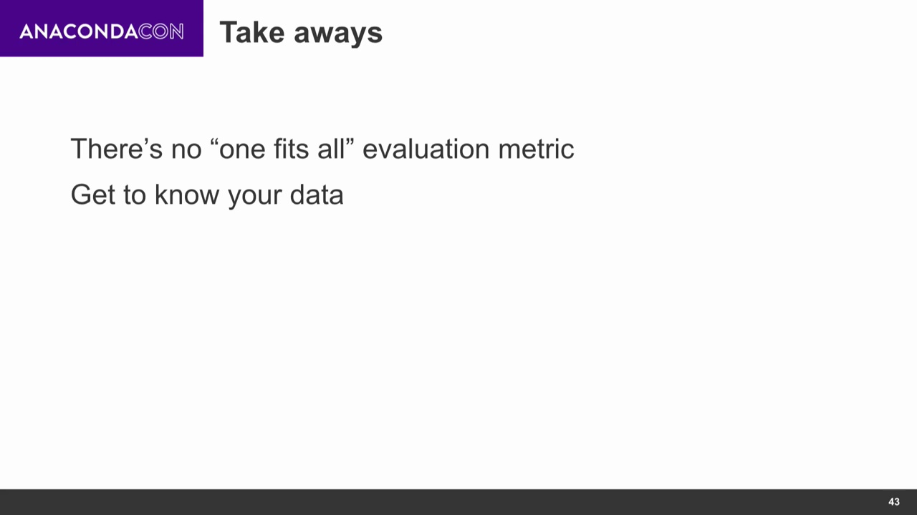

Slide 51


